Slide 1
Gyrfalcon Agricultural Analytics Platform
Go-To-Market Plan
Group 1
Laura Le, Kexin Zhang, Shengqi Zhou, Guotian Kan, Fangzhi Liu, & Archit Manuja
Notes:
Good evening everyone. Thank you for coming to the final public report for the Johns Creek Enterprises
Case. We are team 1. My name is Kexin Zhang.
(everybody say their names)

Slide 2
Agenda
1 - Country/Market Selection Criteria
2 - Go-To-Market Strategy
Location - Australia
Time to Market (Immediate Release of Product)
Advertising - Online and Offline
ROI on Product
Financial Risk Factors (Leveraging Tax Treaty)
Manufacturing in China
Hardware + Software (Partnering with a Drone Manufacturer)
3 - Final Recommendations
Notes:
Today we are going to talk about our market approach. The location we have chosen to explore our market is Australia. In addition, we will also give suggestions about the time to approach the real market, and our advertising strategies. After that we are going to talk about the ROI on our product and also about some financial risks we are prepared for.

Slide 3
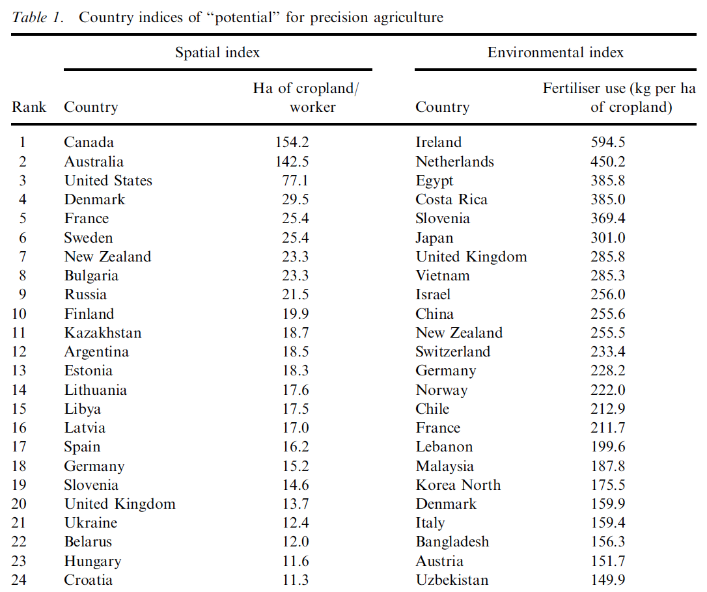
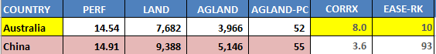
Country/Market Selection Criteria
In Asia
First : China (Coronavirus Scare)
Final Choice: Australia
Table: data given by the board
Source: McBratney, A., Whelan, B., Ancev, T. et al. Future Directions of Precision Agriculture. Precision Agric 6, 7–23 (2005).
Notes:
Table: data given by the board
Source: McBratney, A., Whelan, B., Ancev, T. et al. Future Directions of Precision Agriculture. Precision Agric 6, 7–23 (2005). (Future Directions of Precision Agriculturew ALEX McBRATNEY BRETT WHELAN TIHOMIR ANCEV)
Now let me briefly talk about why we have chosen Australia as our target country.
As we went through the whole excel sheet, we found two countries that caught us the most. They are Australia and China.
They are both countries with high agricultural potential. As we can see from the excel that they both have large territory of land and also a large percentage of agricultural land.
However, Australia has a great advantage in the Ease of Doing Business Ranking. It has got the 10th place while the China is number 93. Australia also out-wins China in the Corruption Perception Index. Moreover, we have to consider that the outbreak of the Coronavirus would bring a negative influence in our potential market in China

Slide 4
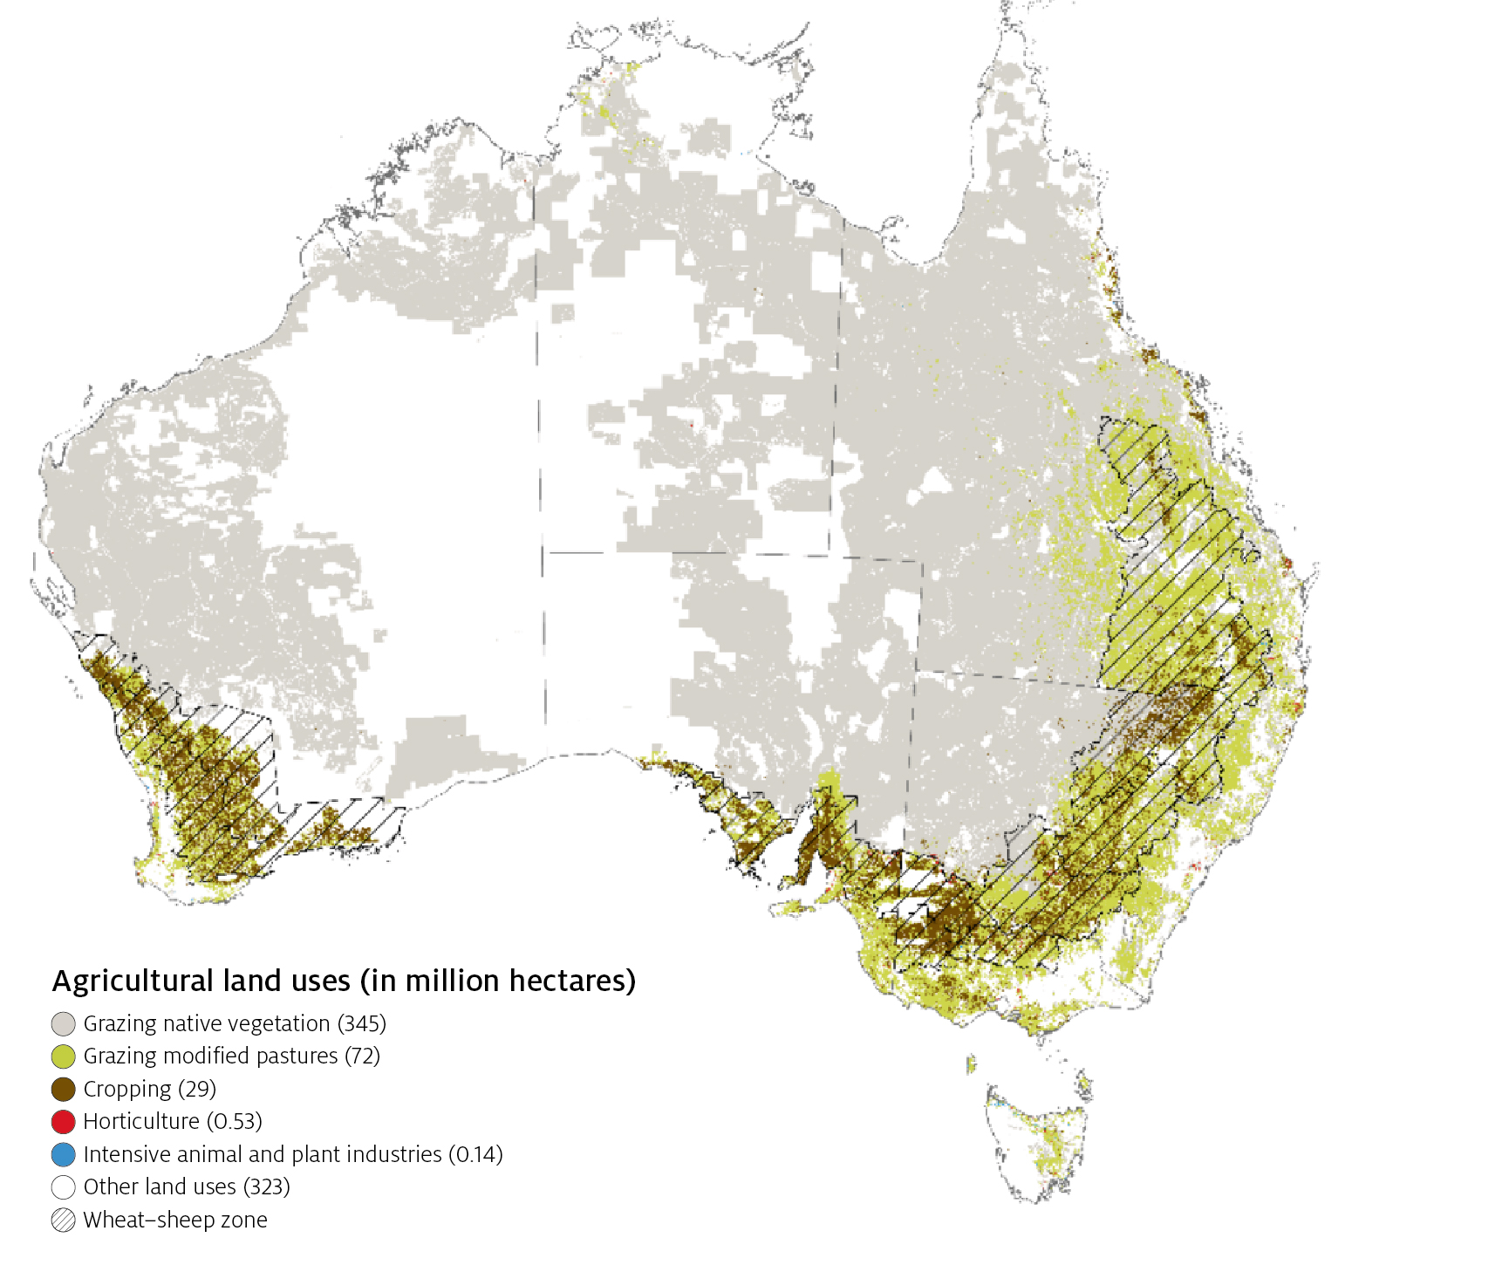

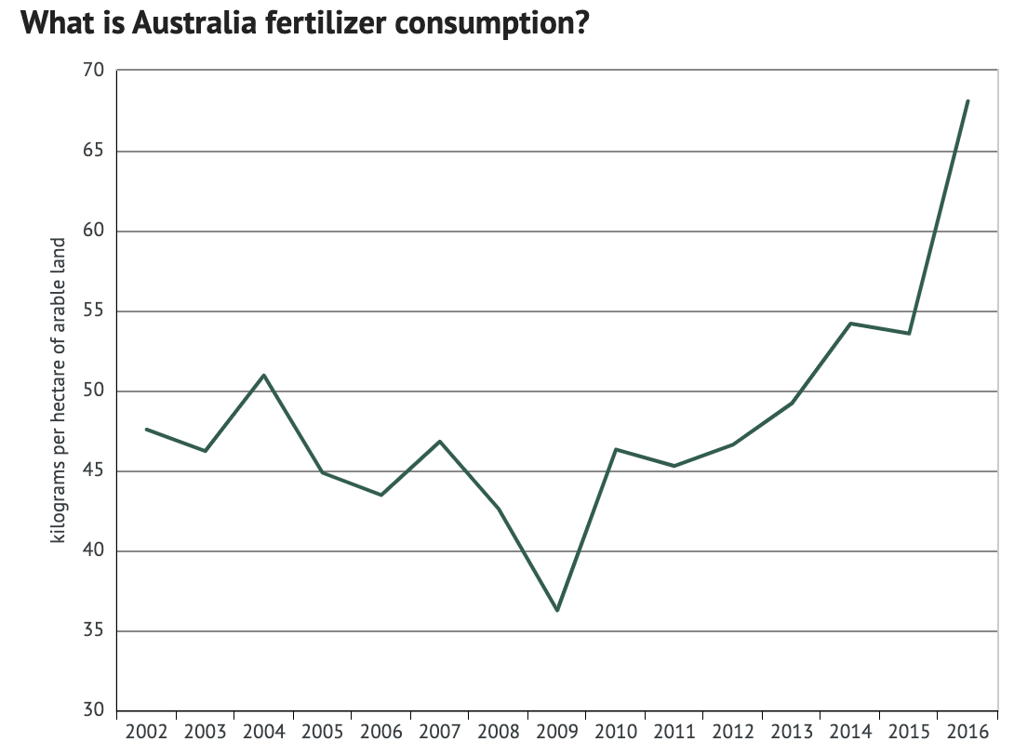
Market Strategy: big corporate farms in Australia
Large field sizes, major in agricultural producer & exporter -
$155 billion/year, 12% share of GDP
Autonomous drone technology has been developed since 2017
Fertiliser consumption increase annually - negative environmental impact.
Source: https://www.agriculture.gov.au/abares/publications/insights/snapshot-of-australian-agriculture
https://knoema.com/atlas/Australia/Fertilizer-consumption
https://www.agriculture.gov.au/abares/publications/insights/snapshot-of-australian-agriculture
Notes:
Source: https://www.agriculture.gov.au/abares/publications/insights/snapshot-of-australian-agriculture
https://knoema.com/atlas/Australia/Fertilizer-consumption
https://www.agriculture.gov.au/abares/publications/insights/snapshot-of-australian-agriculture

Slide 5


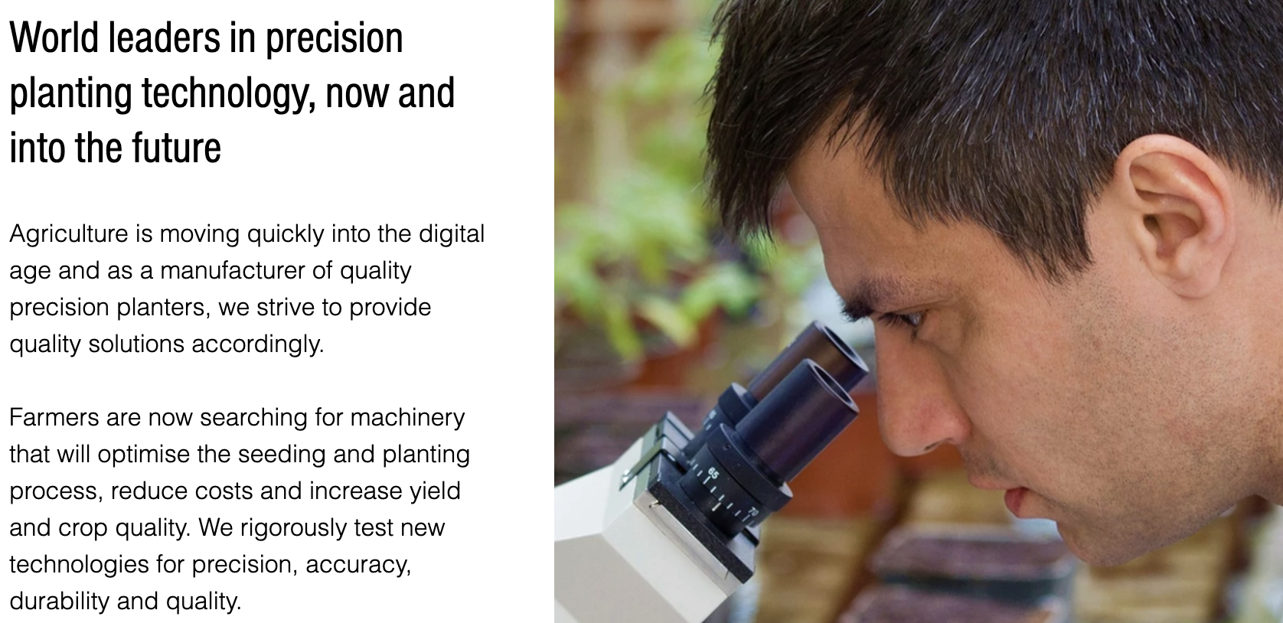
Go-To-Market Strategy:
Immediate Release of Product
Competitor - Ground Breaker Precision Agriculture in Australia
Techniques might be surpassed by competitors in next few years
Making it public sooner can lead to future changes in direction
Source: https://www.groundbreaker.com.au/about-us

Slide 6
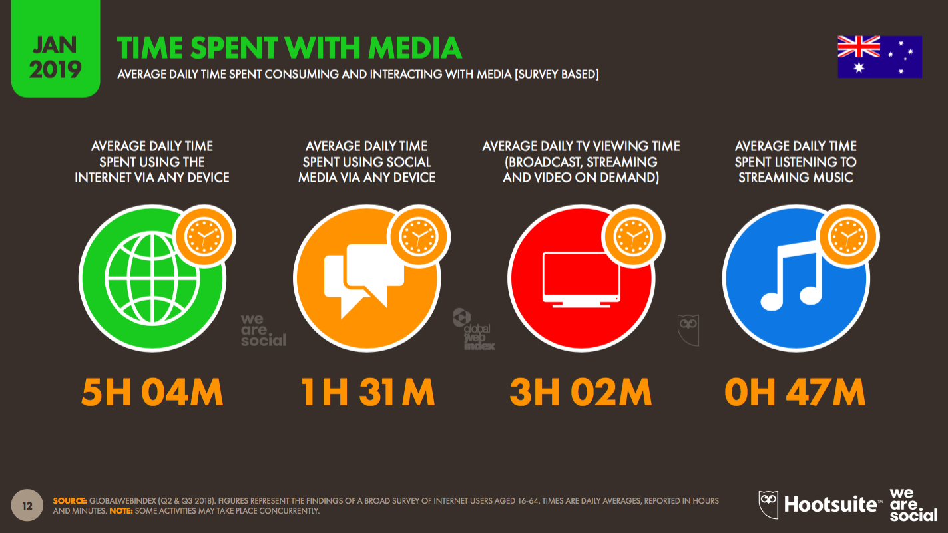
Go-To-Market Strategy:Online Advertising
Australians spend more than 5 hour/day using the internet
Source: https://learn.g2.com/omnichannel-marketing
Notes:
Image left: Source: https://learn.g2.com/omnichannel-marketing

Slide 7
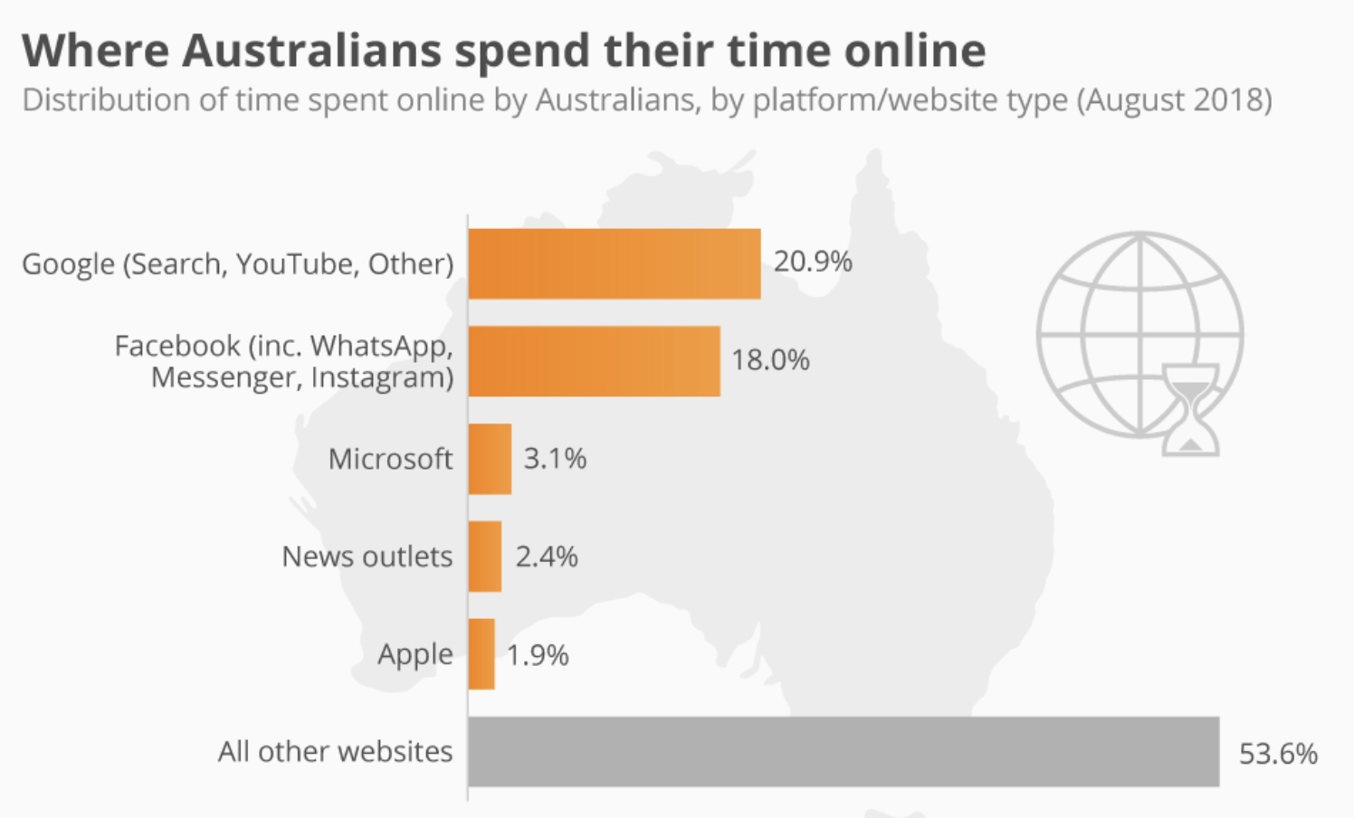
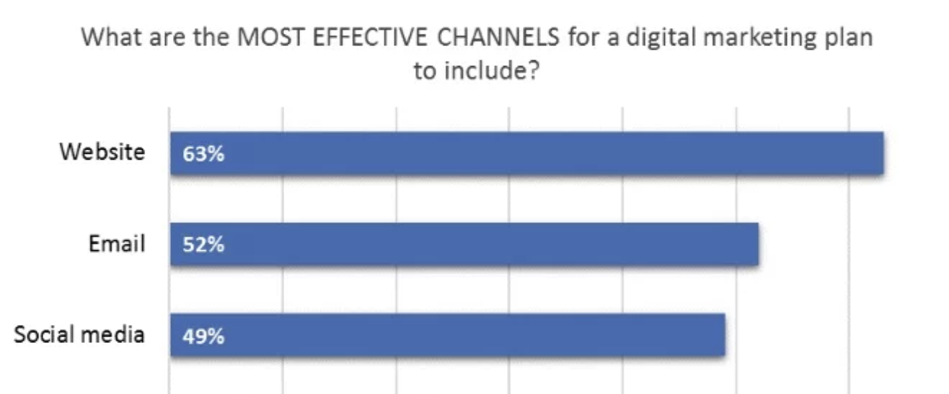
Go-To-Market Strategy:Online Advertising
Google generates 3.5 billion searches everyday
6 in 10 Australians use Facebook
Source: https://wearesocial.com/au/blog/2019/02/digital-report-australia
https://www.statista.com/chart/16405/where-australians-spend-their-time-online/

Slide 8
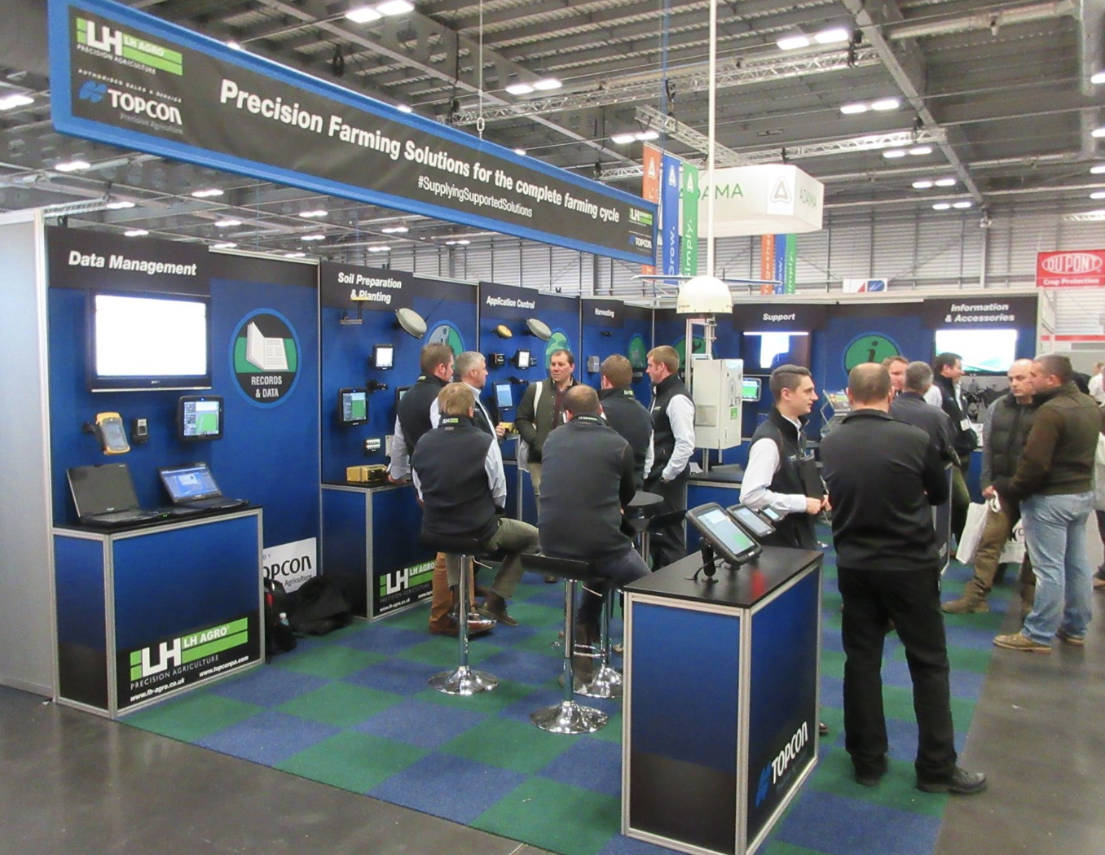
Go-To-Market Strategy:Offline Marketing
Trade show / Road show / Events in Australia
Direct connection with customer
Make our product more approachable
Drive traffic to our website
Increase brand awareness
Source: https://wearesocial.com/au/blog/2019/02/digital-report-australia

Slide 9
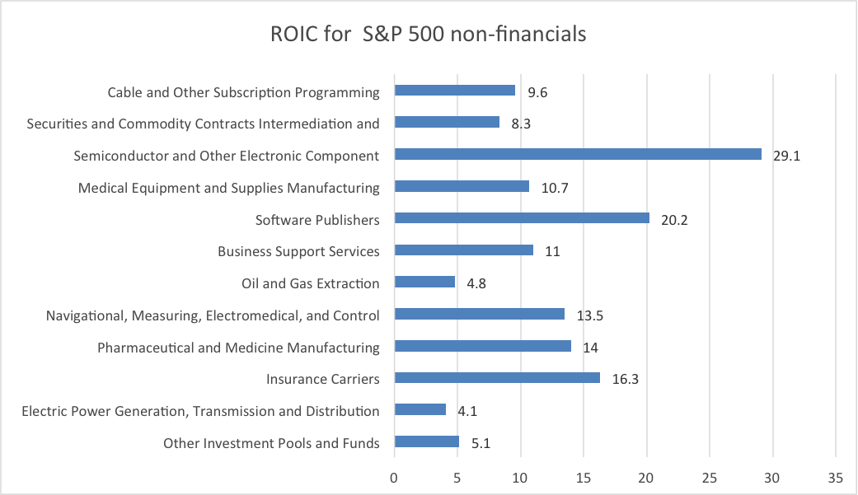
Go-To-Market Strategy:
Determine Market Profitability - ROI
Target: Greater than 12.31% (U.S.), 11.43% (Australia)
Calculated based on 8% WACC and 35% U.S. tax rate (30% for Australia)
Lower ROI means no profit on capital invested
Most healthy public companies have ROIC greater, with higher WACC
Source: https://valuereports.economatica.com/roic-sp-500-performance/

Slide 10

Go-To-Market Strategy:
Financial Risk Factors
-Exchange rate fluctuation
-Potential economic downturn
-Double taxation
Notes:
It is crucial to take some financial risk factors into account in order to achieve our goal, that is, maximize the profit as soon as possible. To have successful international business in Australia, we have to recognize the diversity of the world marketplace and be able to cope with uncertainties and risks.

Slide 11
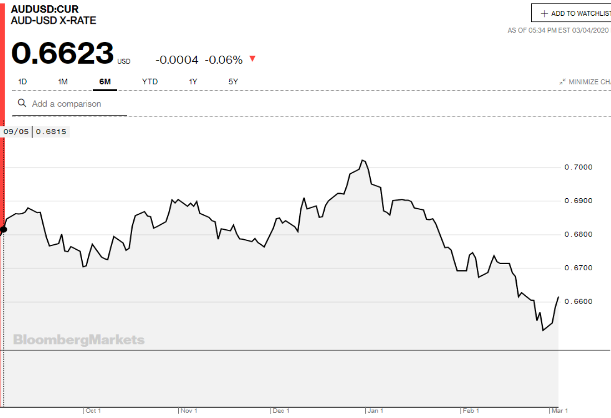
Exchange rate fluctuates over time
Solution:
Purchase hedging instruments
Source https://www.bloomberg.com/quote/AUDUSD:CUR
Notes:
The exchange rates between USD and AUD fluctuate all the time. Because we are doing international business, We will have lots of foreign currency assets, and the value of it will go up or down and finally result in exchange gain/loss. To avoid these uncertainty, we should purchase hedging instruments to offset the risk, preventing any exchange losses.

Slide 12
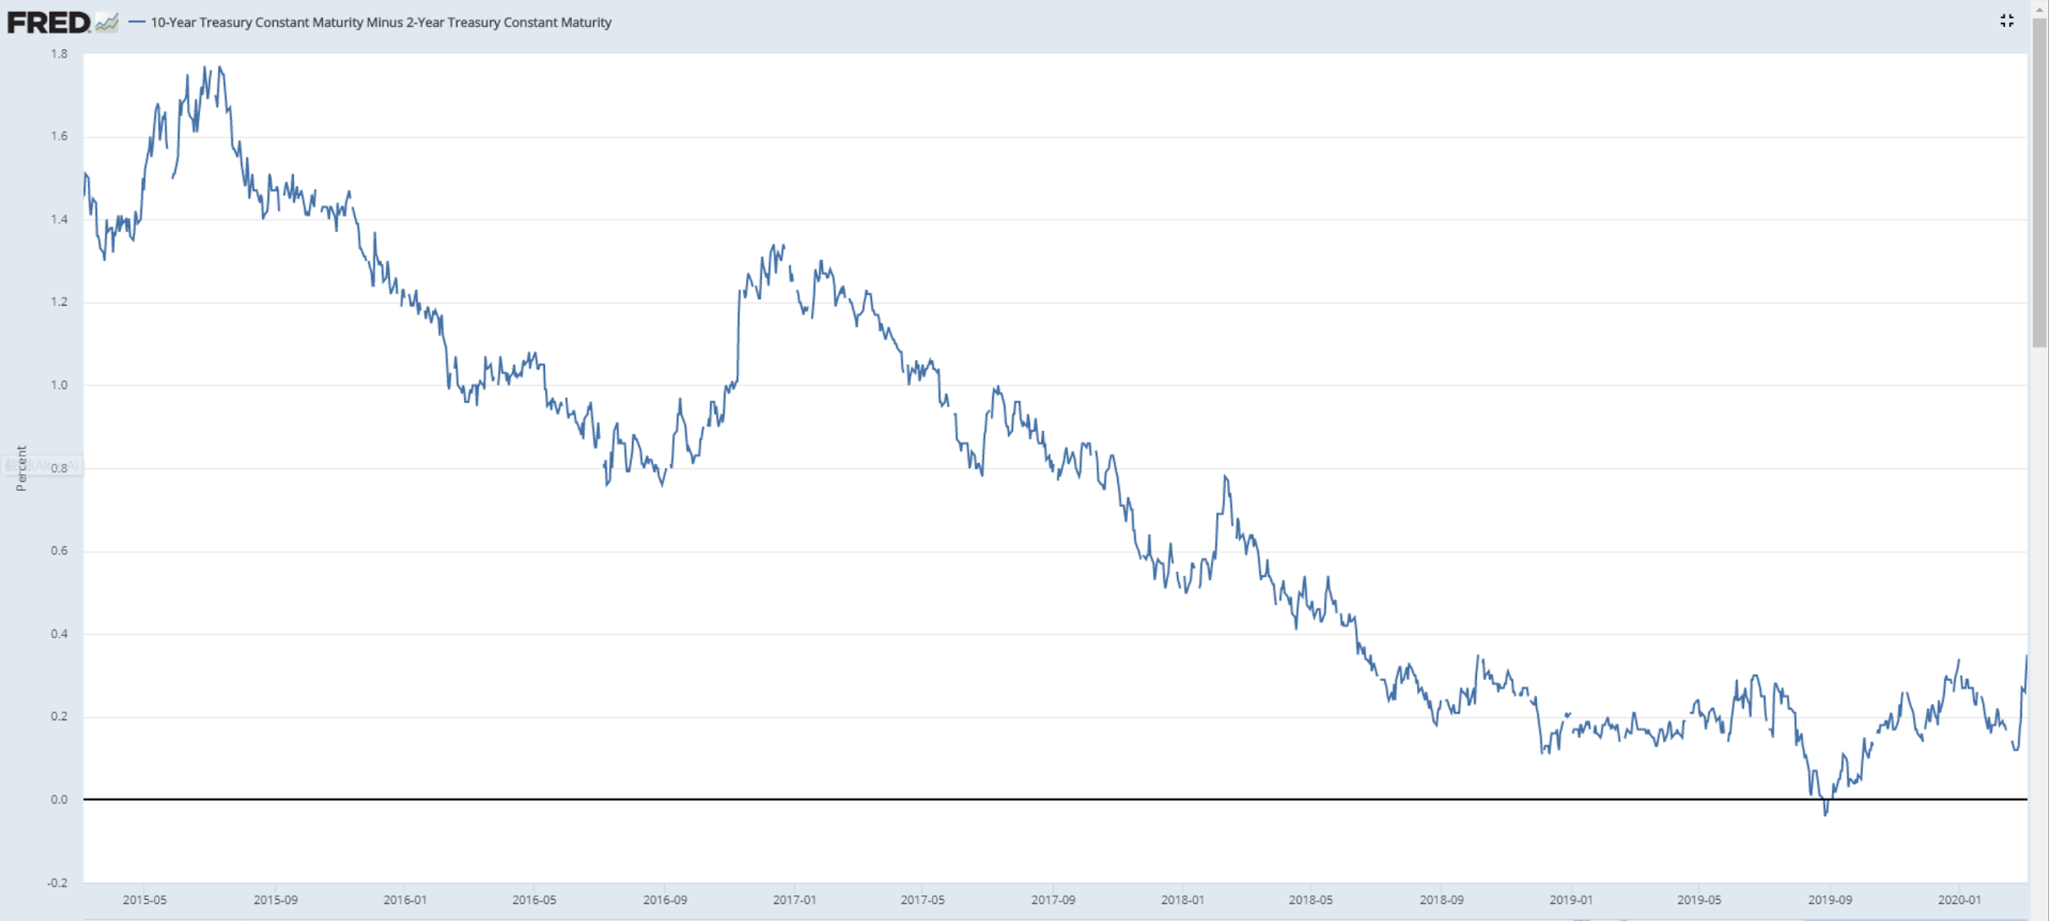
Potential economic downturn
Solution:
Corporate with third party collection agency to recover loss as much as possible from default credit sales.
Source: https://fred.stlouisfed.org/series/T10Y2Y
Notes:
https://fred.stlouisfed.org/series/T10Y2Y
There also might be a potential economic downturn in the future. The picture here shows the difference between the yield of 10 year t bill and 2 year t bill. As we can see from the picture, the difference has been decayding since 2015, and we can find that people are not confident about the economy in the long run, and may be a world wide recession. If it really happens, lots of companies not only in the USA but also in Australia will have a hard time in the near future, their ability to pay will be impaired. Which will increase default risk.
The solution is going to be: Corporate with third party collection agency to recover loss as much as possible from default credit sales.

Slide 13
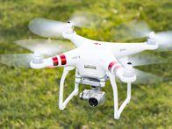
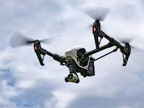
Go-To-Market Strategy:
Financial Risk Factors
A subsidiary or a branch?
Build oversea Subsidiaries
Transfer funds by paying dividends to the parent company to relieve double taxation issues
Notes:
Finally, we have to decide whether to establish a branch or an oversea subsidiary in Australia. The US is one of the two countries that have a Residency Based Taxation System. Our company is a us based company, which means it should be recognized as a US resident, all the oversea income we obtained will be taxed again after paying the AU’s corporate tax.
To relieve the double taxation issue, our best try is to establish an oversea subsidiary and transfer funds by paying dividends to the parent company, which will result in lower tax rate.

Slide 14
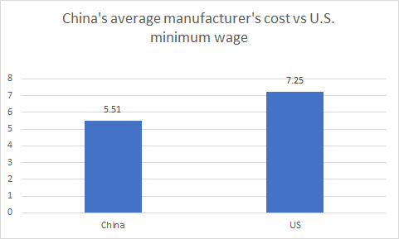
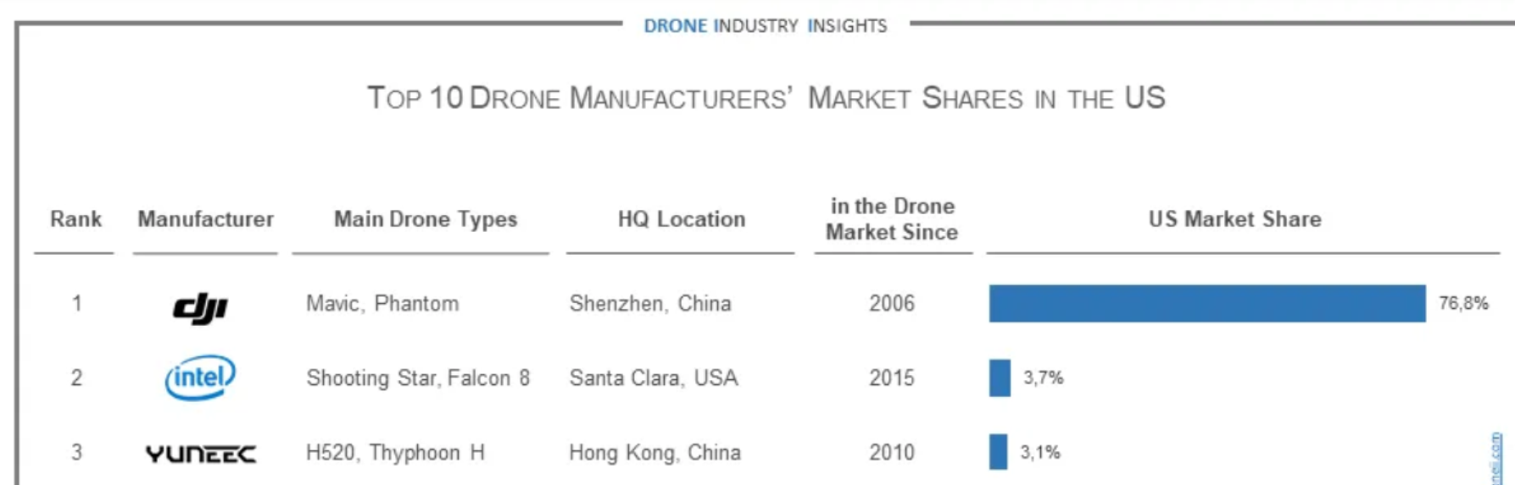
Go-To-Market Strategy:
Manufacturing in China
One of the top manufacturer in technology: both quantity and quality, with a lower cost.
One of the largest and the best drone providers in the world: potential partnership opportunity to provide customers with drones as well.
Source: https://www.droneii.com/drone-manufacturer-market-shares-dji-leads-the-way-in-the-us
https://www.statista.com/statistics/744071/manufacturing-labor-costs-per-hour-china-vietnam-mexico/
Notes:
Source: https://www.droneii.com/drone-manufacturer-market-shares-dji-leads-the-way-in-the-us
https://www.statista.com/statistics/744071/manufacturing-labor-costs-per-hour-china-vietnam-mexico/

Slide 15
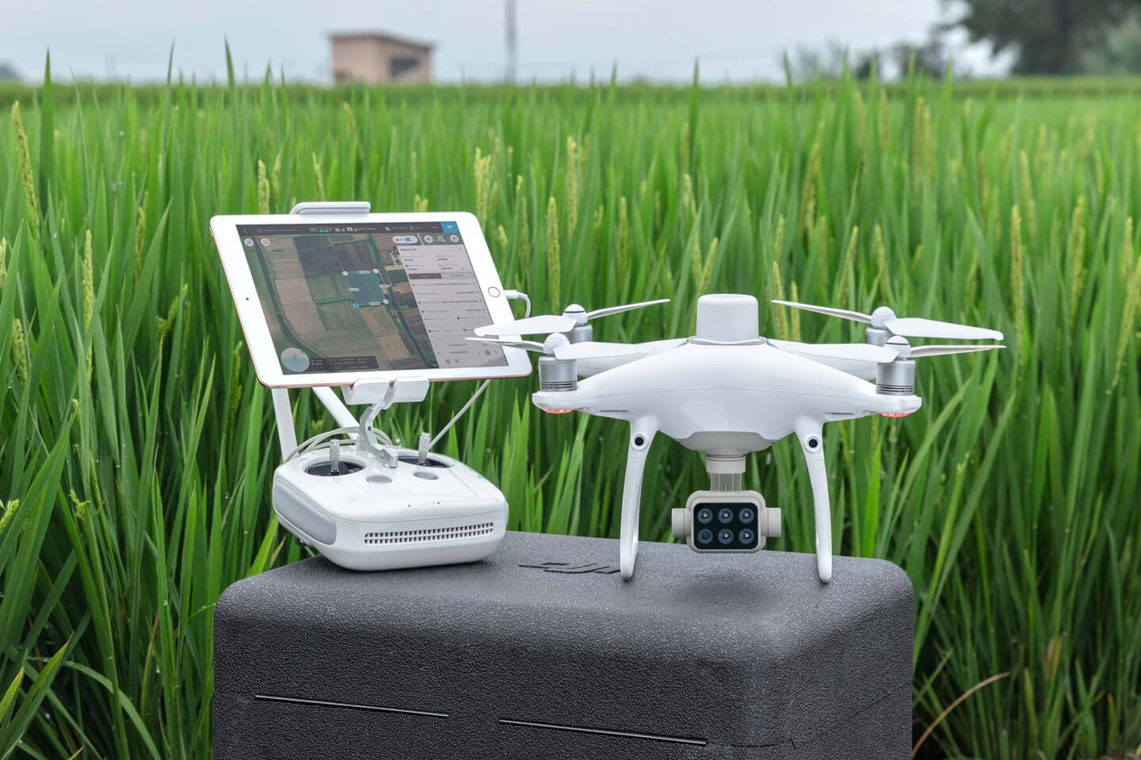
Go-To-Market Strategy:
Hardware + Software
Ensure no breach to the government regulation of drones.
Ensure no technical problem due to drones.
Lower price of drones can attract more customers.
Can be achieved by partnering with a Chinese drone manufacturer.
Optional package with drone: more flexibility to customers.
Source: https://dronedj.com/2019/09/24/dji-phantom-4-multispectral/
Notes:
Source: https://dronedj.com/2019/09/24/dji-phantom-4-multispectral/

Slide 16

Potential Limitations/Obstacles
Limited or lack of government cooperation/support
Lack of knowledge/ability to use or apply the product
High customer acquisition costs
A knock-off product enters market before 3-5 year time frame
Cash flow issues - adjusting for in the budget
Source: https://www.adorama.com/alc/what-are-the-best-drones-with-4k-cameras
https://news.wsu.edu/2019/07/22/protecting-vineyards-drones/
Notes:
Australia already has a tax treaty in place
Account for these in our budget
Image (right): https://www.adorama.com/alc/what-are-the-best-drones-with-4k-cameras
Image (left): https://news.wsu.edu/2019/07/22/protecting-vineyards-drones/

Slide 17
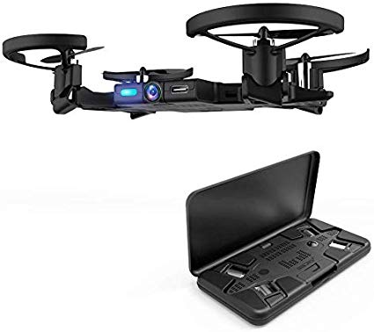
Final Recommendations
International Market to Infiltrate: big corporate farms in Australia
Minimal Time to Market: Immediate Release of Product
Advertising Through: Ads on Google / Facebook & Trade Shows in Australia
Manufacturing Products in a Cheap-Labor Market: China
Source: https://www.amazon.com/AEE-Foldable-Propellers-Technology-Quadcopter/dp/B07T18XRMV
Notes:
Image: https://www.amazon.com/AEE-Foldable-Propellers-Technology-Quadcopter/dp/B07T18XRMV

Slide 18
Questions?

Slide 19
Sources
McBratney, A., Whelan, B., Ancev, T. et al. Future Directions of Precision Agriculture. Precision Agric 6, 7–23 (2005).
https://www.environment.gov.au/climate-change/climate-science-data/climate-science/impacts
https://blog.agrivi.com/post/benefits-of-using-precision-farming-producing-more-with-less
https://www.precisionag.com/market-watch/australia-autonomous-drone-technology-improves-irrigation-practices/
https://valuereports.economatica.com/roic-sp-500-performance/
https://www.statista.com/statistics/744071/manufacturing-labor-costs-per-hour-china-vietnam-mexico/
https://airdronecraze.com/drone-manufacturers/
https://www.chinaimportal.com/blog/drone-manufacturers-china/
https://www.irs.gov/pub/irs-trty/aus.pdf
https://seotribunal.com/blog/google-stats-and-facts/
https://knoema.com/atlas/Australia/Fertilizer-consumption
https://blog.marketo.com/2015/08/on-the-road-again-4-reasons-why-roadshows-are-your-new-best-friend.html
https://www.droneii.com/drone-manufacturer-market-shares-dji-leads-the-way-in-the-us
https://fred.stlouisfed.org/series/T10Y2Y
https://dronedj.com/2019/09/24/dji-phantom-4-multispectral/
https://www.droneii.com/drone-manufacturer-market-shares-dji-leads-the-way-in-the-us
https://wearesocial.com/au/blog/2019/02/digital-report-australia
https://www.statista.com/statistics/729978/australia-most-often-used-social-media-brands/
https://www.groundbreaker.com.au/about-us
https://www.topconpositioning.com/agriculture
https://www.statista.com/chart/16405/where-australians-spend-their-time-online/
https://neilpatel.com/blog/marketing-channels/

